Slide 1
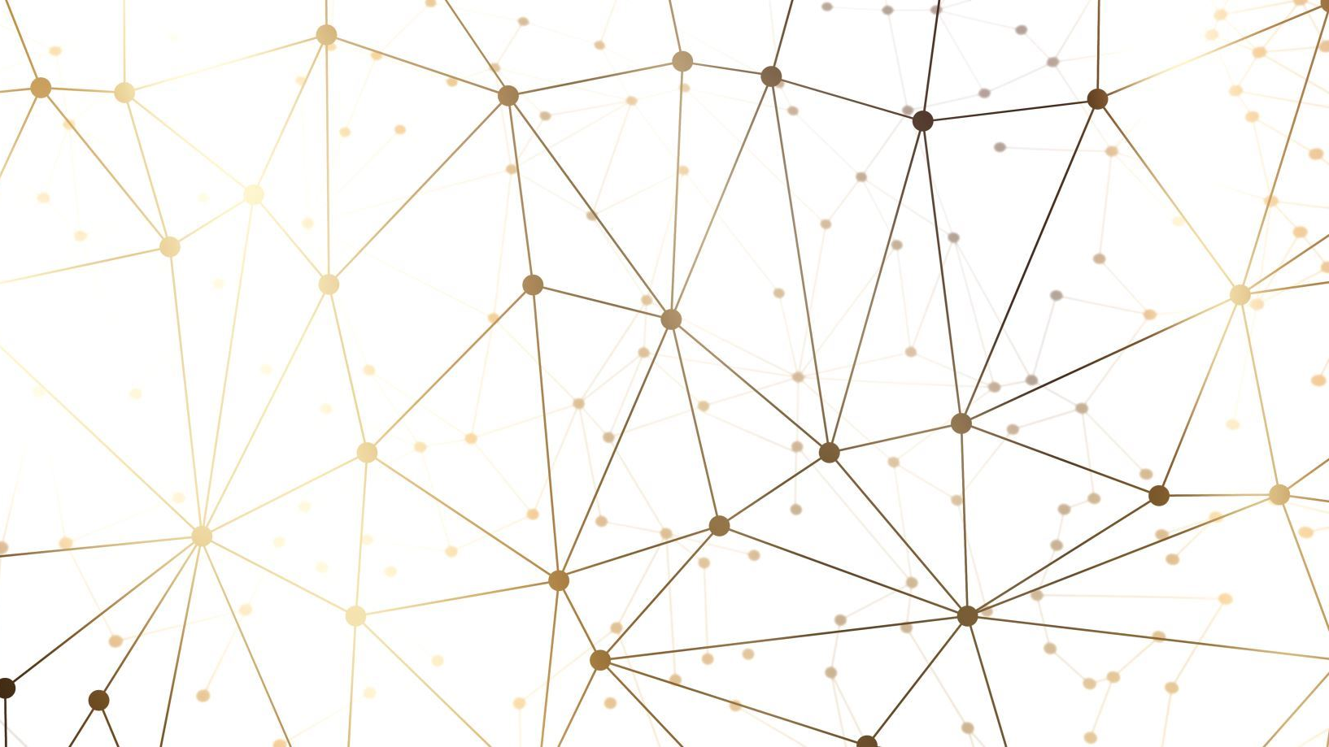

SEMN
Project Purpose and Goal Statement: Create an application that uses AI to generate user described images.

Slide 2
Our Team:
Sara Marijolovic – marijosm@mail.uc.edu - 440-662-3814
Eli Detmers – detmerej@mail.uc.edu - 260-341-9032
Michael Pappa – pappamr@mail.uc.edu - 614-824-9671
Nick Murray – murraynl@mail.uc.edu - 614-800-0056
Project Advisor:
Dr. Will Hawkins

Slide 3
Project Abstract
By using AI image generation, users will be able to create custom pictures based on prompts they give as input to the application. Custom pictures will be uploaded to our application and the user will apply tags to the image. Our AI data model will be able to read the images/tags and use them to generate images. For example, if a user uploads a picture of their friend, (we'll call the friend Eli), then the user could tell the AI to generate an image of Eli jumping a motorcycle over a volcano, and the AI will create that image for them to use however they prefer. After the images are generated, they can be exported to the user's device and used at their discretion.
Using android phone

Slide 4
User Stories
A college student who wants to decorate their dorm with personalized wallpapers that they can make in our AI application, so that they can make their room look more vibrant.
Teenage/young adults who want to give our personal gifts to friends or relatives with pictures of them together to show their closeness.
A widowed person who wants to recreate a memory of themselves and their loved one through AI imaging so that their memory can live on.

Slide 5
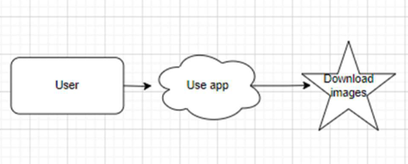
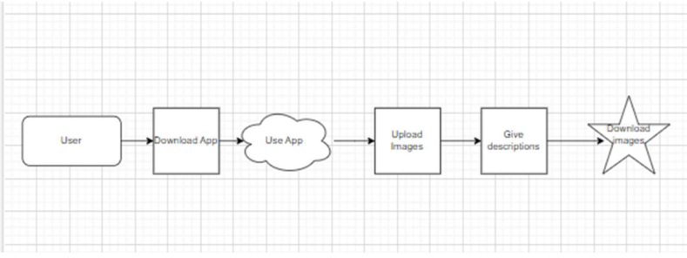
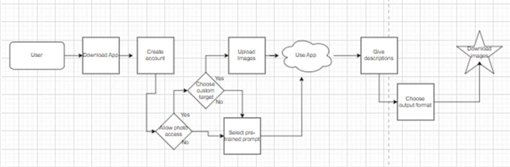
Design Diagrams

Slide 6
Project Constraints
Legal
Pre-established image generation models
Security
Storage and privacy of personal photos
Social
Opportunity to create fabricated backgrounds
Ethical
Opportunity to use photos without consent and create incriminating photos

Slide 7
Review of Project Progress
Project Roadmap
We have created a guide that we which we will follow from start to finish.
Team Roles
We have split our project up into the most efficient roles based on each other's strengths.
Team Goals
Our team has come up with individual and team goals that we will achieve throughout the course of the next two semesters.

Slide 8
Expected Accomplishments for End of Term
Project Planning
Updating roadmap as we start the development for more accurate goals
We will have a list of actionable items and a schedule of when to complete them.
Project Start
Each one of us will do research on the most efficient way to go about our parts of the project.
We will then begin to build our application

Slide 9
Division of Work
Sara Marijolovic – Quality assurance, testing, developer
Eli Detmers - Secondary developer and lead AI researcher
Michael Pappa - Secondary developer and project administrator
Nick Murray – Lead developer

Slide 10
Expected Demo at Expo
Using Android phone
Phone screen will be mirrored to a larger screen
Attendees will be able to take a picture and upload it to the model
Attendees can then use the newly trained model to create AI images with themselves

